Slide 1
Surveillance – Enhanced
Collision Avoidance
Final Presentation
Rohit Annigeri Akash Joshi Yifei Shen Thaddaeus Voss
Notes:
1

Slide 2
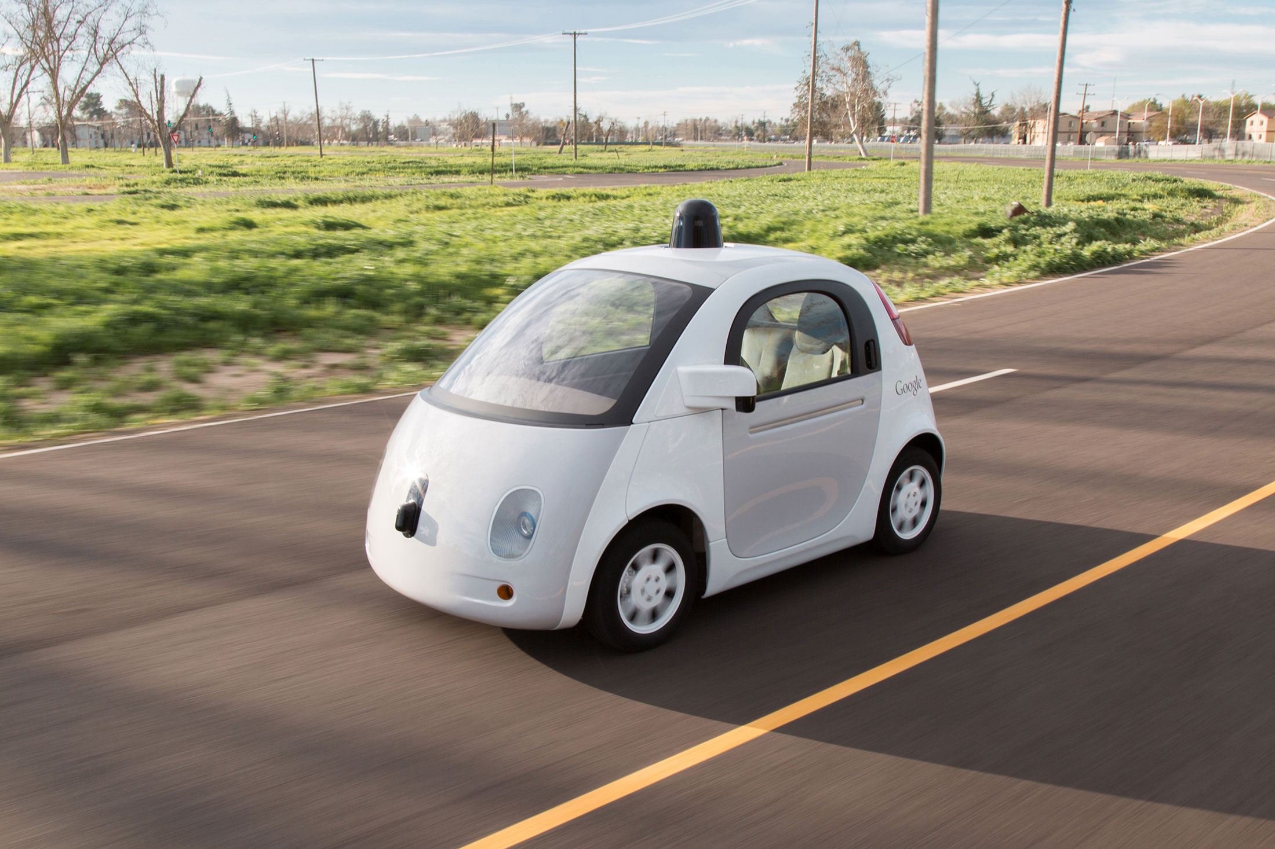
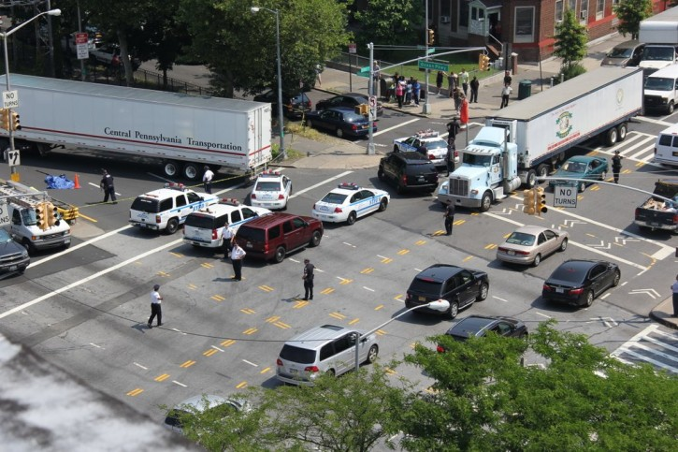
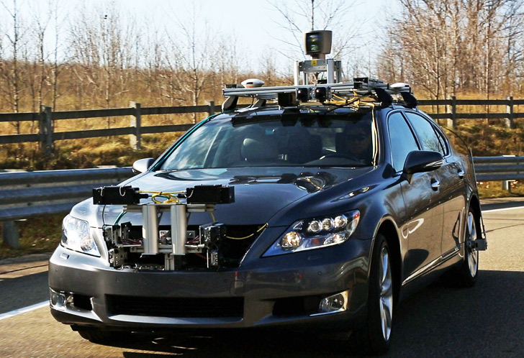
Motivation
Notes:
2

Slide 3
System Description
Two cars running in the field
Final System
Simulating the collision scenario with two remote control cars and using a simple lab camera as surveillance camera, send instructions to take control the cars when it’s necessary to avoid collision.
Camera to DSP board
Track the cars using background subtraction and classify them with color
Predict the cars location in future
Predict the possibility of collision
Send messages to cars and control their movement when necessary to avoid collision and keep them inside the boundary

Slide 4
Algorithms: Flow Chart
Video Feed
Background Removal
Object Identification
Trajectory Estimation
Collision calculation and response transmission
Notes:
4

Slide 5
Algorithms: Low Level View
Background Subtraction
- Estimate background to identify foreground objects. Used Gaussian model to tag background (Initial training)([4])
Object Identification
- Offline : Used LDA to classify between foreground and cars.
- Online : Explore foreground pixels to distinguish between cars. Used Color statistics.
Notes:
5

Slide 6
Algorithms: Low Level View (contd)
Trajectory Estimation/ Retrieval:
- Offline: Kalman filter based path estimation [5][7]
- Online: Predicted position based on car speed and ability to make decisive turn.
Collision Prediction and Response Transmission:
- Thresholding on distance after which collision is not preventable.
- Making appropriate action to avoid collision. Transmission to cars.
Notes:
6

Slide 7
Complexity Analysis
Two Part System
(1) Control center, with a real time video feed, DSP and a RF transmitter
(2) Local environment, consisting of an intersection and independent cars with RF receivers
Bottlenecks
- Foreground object detection (background removal)
- Turning decision calculation
- Transmission rate from DSP to car.
Notes:
7

Slide 8
Challenges
Accurate background estimation, changing background [4]
Speeding up overall execution.
Distinguishing between the cars.
Turn Decision calculation and response transmission.
Notes:
8

Slide 9
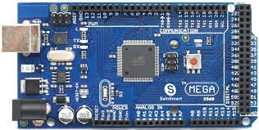
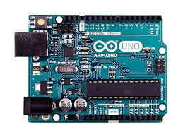
Modeling Tasks
Build two autonomously driven RC cars to model the collision system
Cars: Hobbyist Motors + Wheels
Receivers: Arduino Uno (x2)
Transmitter: Arduino ATmega2560
One-way communication to both of the cars simultaneously from the DSP board through the transmitter
Notes:
9

Slide 10
Final Schedule
 | Milestone | Associated Tasks | Completion Date
Milestone 1 | Detect objects in a scene, identify each of the objects, and predict future location | Isolate moving objects from background (R, Y) Detect objects in the scene (R, T) Identify objects (R, T) Predict future location (Y, R) | March 13
Milestone 2 | Successfully run intersection simulation using remote-controlled cars | Obtain two remote-controlled cars (A) Develop code to control two cars using relevant hardware (A) Perform tests controlling cars at different speeds, in collision and non-collision scenarios (R, Y, T, A) | April 7
Milestone 3 | Derive percentage likelihood of a crash using car metrics and apply these warnings to intersection simulation | Transmit successfully over GPIO to remote-controlled cars (A, R) Develop algorithm to keep cars within the intersection (R, T, Y) Develop and implement algorithms to avoid a collision (Y, R, T, A) | April 19

Slide 11
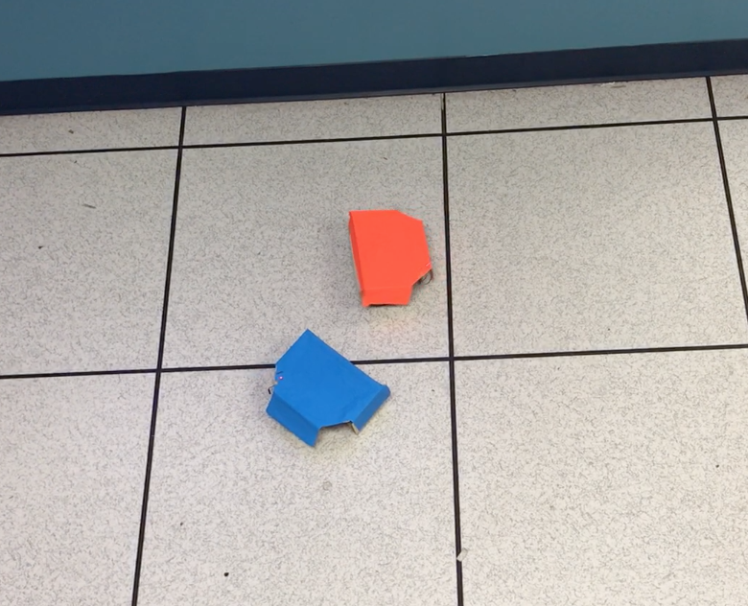
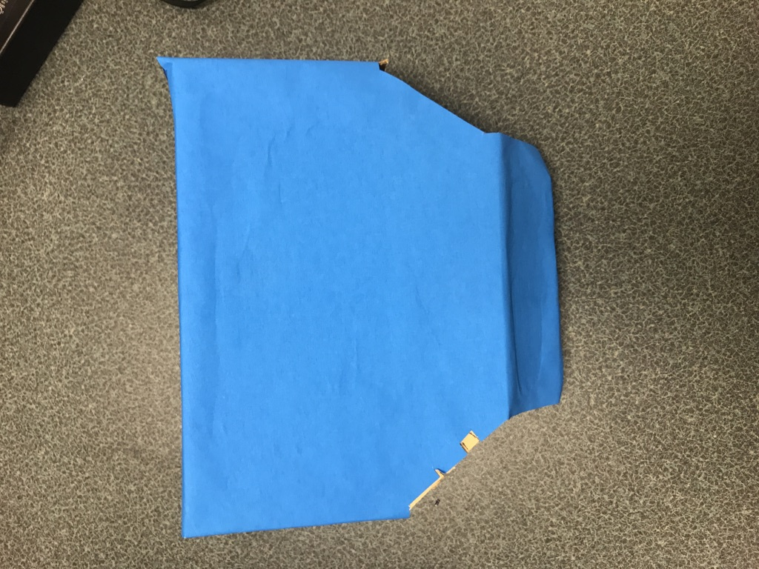
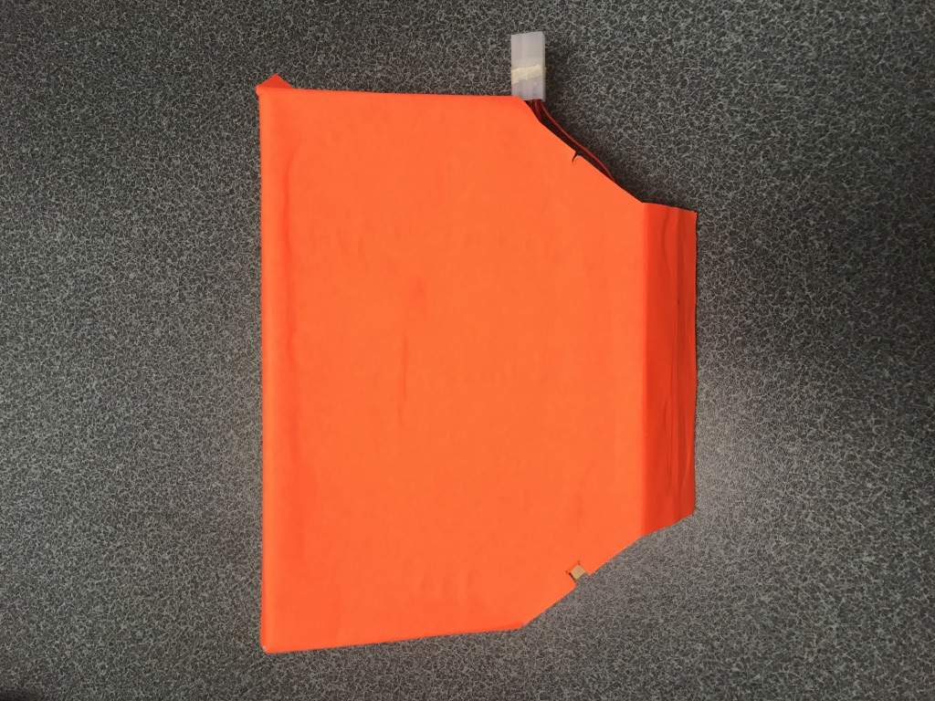
Final Test Setup
Equipment
TI TMS320C6416 Fixed-Point DSP Board
Overhead Video Camera
Remote-Controlled Cars (2) and RF Transmission Board
Simulation
Remote-controlled cars running on a mock intersection, with camera capturing live video of the entire intersection from directly above, fed into the DSP
Movement data of cars overlaid onto live feed
Test scenarios for vehicle-vehicle non-collision, near-collision, and collision instances run, with vehicles being corrected by the DSP if a collision is imminent

Slide 12
References
[1] https://www.bloomberg.com/news/articles/2016-09-12/google-car-project-loses-leaders-and-advantage-as-rivals-gain
[2] http://inhabitat.com/lexus-unveils-autonomous-advanced-active-safety-research-vehicle-at-ces-2013/
[3] https://www.newyorkpersonalinjuryattorneysblog.com/2013/08/new_york_accident_prevention_p_1.html
[4] J. Gallego, M. Pardàs, and G. Haro, "Enhanced foreground segmentation and tracking combining Bayesian background, shadow and foreground modeling," Pattern Recognition Letters, vol. 33, no. 12, pp. 1558–1568, Sep. 2012.
[5]. [Online]. Available: http://www.cc.gatech.edu/~ksubrama/files/FPGA_Report.pdf. Accessed: Feb. 13, 2017.
[6]. [Online]. Available: http://www.kev-smith.com/papers/smith-thesis.pdf. Accessed: Feb. 13, 2017.
[7]. S. Kang; J. Paik; A. Koschan; B. Abidi & M. A. Abidi (2003). "Real-time video tracking using PTZ cameras". Proc. SPIE. 5132: 103–111. CiteSeerX 10.1.1.101.4242Freely accessible. doi:10.1117/12.514945.
[8] https://www.youtube.com/watch?v=eMl5u-iENr4
[9] https://www.youtube.com/watch?v=nsHYg3ENgk4
[10 ]http://snakeclamp.com/blog/wp-content/uploads/2015/06/DSLR-overhead-2-reduced.jpg
[11] http://www.ti.com/diagrams/med_tmdsdsk6416_6416_kit_72.jpg
[12] https://i.ytimg.com/vi/7Vrk0xX7cUQ/hqdefault.jpg
[13] https://www.isr.umd.edu/~austin/enes489p/projects2011a/CollisionAvoidance-FinalReport.pdf

Slide 13
Questions?

